Slide 1
Java Programming
Write once, run anywhere

Slide 2
Content of the Day
Module3: Java Advanced | 0- Recap of Java Basics 1- Recap on Object-Oriented Programming (OOP) Concepts 2- Strings 3- Exceptions 4- Generics

Slide 3
3.2
Exception Handling
Building Robust and Resilient Java Programs

Slide 4
Exceptions
What is Exception
Try-catch block
Multiple catch
Finally
Throw

Slide 5
What is Exception ?
In Java, an exception is an event that disrupts the normal flow of the program. It is an object which is thrown at runtime.
What is Exception Handling ?
Exception Handling is a mechanism to handle runtime errors such as ClassNotFoundException, IOException, SQLException, RemoteException, etc.

Slide 6
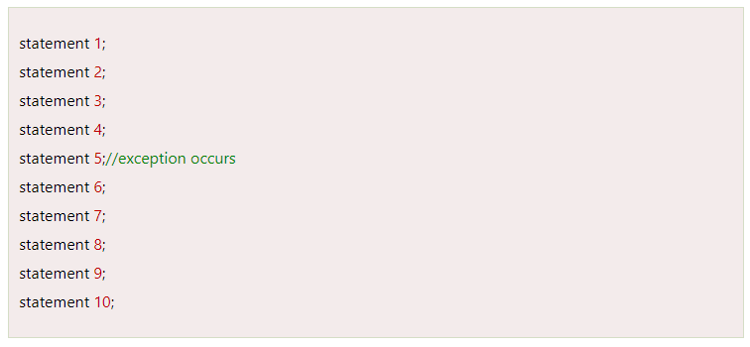
Exception
Notes:
Suppose there are 10 statements in a Java program and an exception occurs at statement 5; the rest of the code will not be executed, i.e., statements 6 to 10 will not be executed. However, when we perform exception handling, the rest of the statements will be executed. That is why we use exception handling in Java.

Slide 7
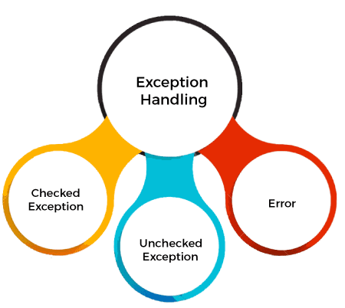
Types of Java Exceptions

Slide 8
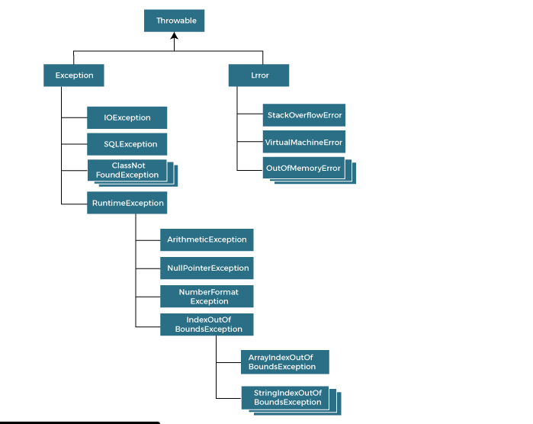
Types of Java Exceptions

Slide 9

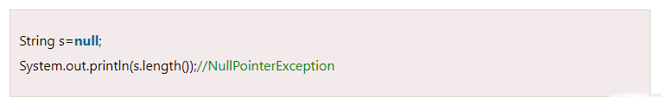
Scenarios

Slide 10
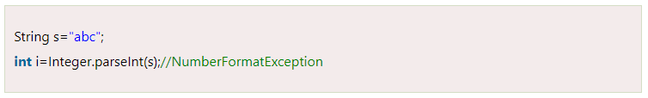
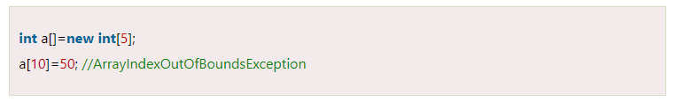
Scenarios

Slide 11
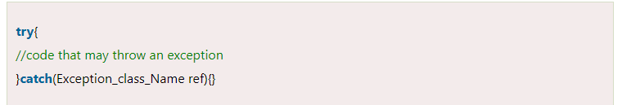
Solution : try - catch

Slide 12
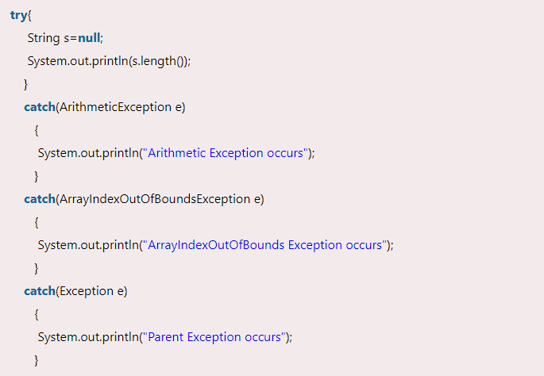
Java Multi-catch block
Notes:
A try block can be followed by one or more catch blocks. Each catch block must contain a different exception handler. So, if you have to perform different tasks at the occurrence of different exceptions, use java multi-catch block.

Slide 13
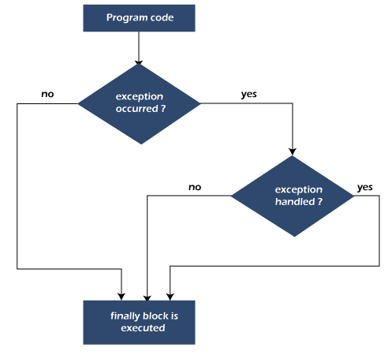
Java finally block
Notes:
Java finally block is a block used to execute important code such as closing the connection, etc.
Java finally block is always executed whether an exception is handled or not. Therefore, it contains all the necessary statements that need to be printed regardless of the exception occurs or not.

Slide 14
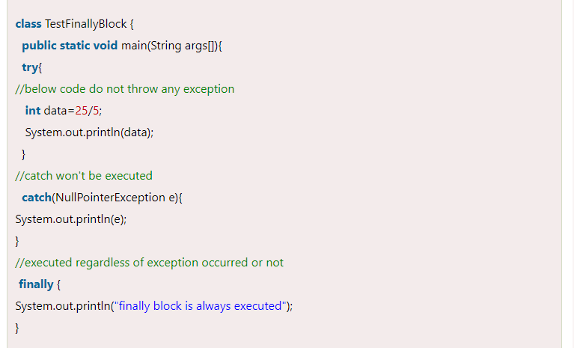
Java finally block
Notes:
Why use Java finally block?
finally block in Java can be used to put "cleanup" code such as closing a file, closing connection, etc.
The important statements to be printed can be placed in the finally block.
Rule: For each try block there can be zero or more catch blocks, but only one finally block.

Slide 15
—Anonymous
"Transforming errors into stepping stones on the path to robust code."

Slide 16
Thanks!
Do you have any questions?
amerosama.jr@gmail.com
01007698027

